Slide 1
What is diffusion?
Spread of objects, ideas, information, concepts, fashions, tastes, practices etc. in a social network
  Elements of diffusion:
    Actors
      Usually people but also groups, organizations, etc.
    Flow
      From source to adopter
    Mechanism
      Imitation, influence, transfer, etc.
    Outcome
      Adoption, conversion, infection

Slide 2

Diffusion Curve
Ryan, B. and N.C. Gross (1943) The Diffusion of Hybrid Seed Corn in Two Iowa Communities, Rural Sociology, 8: 15-24.

Slide 3
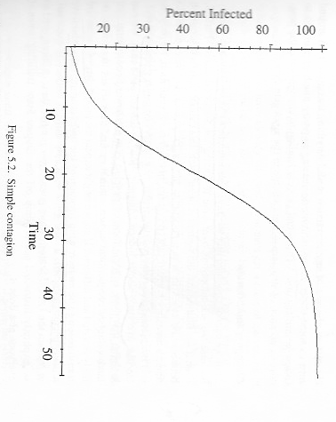
Basic Contagion Model
(Coleman, 1957, Martin 2009, p. 156)
x = number of carriers
N = number of people (vertices)
Probability that i will transmit O (some object) to j is a function of
p: probability that i and j will encounter each other (i.e. are adjacent, a_{ij} = 1)
probability that i is a carrier given that j is not = x/(N-1)
probability that j is not a carrier = (N-x)/N
q: probability of transmission (susceptibility)
Number of transmissions in a time period is
pqx(N-x)
Martin:
  contagion: when q = 1 (open
  diffusion (influence): selective adoption
non-adjacent contagion (peer pressure) : q is a function of x

Slide 4
Diffusion: Issues and Questions
Exposure (p) vs. susceptibility (q)
Structural equivalence vs. influence
  Non-adjacent diffusion
Event timing (Moody) --> probability of exposure (p)
Distinguishing homophily vs influence
  p = Pr(A_{ij}) = f(Q_{i}, Q_{j}, d_{ij})
Determinants of exposure (p)
  network density (ER random graph)
  network structure: isolates, clustering, path lengths, short cuts
  network position
    degree
    concurrence
    in vs. out degree
Broadcasting vs. network diffusion (viral marketing)
  Broadcasting: high p, low q
  Network diffusion: low p, high q

Slide 5
Cohesion (influence) vs. Structural Equivalence (similarity), Burt (1987)
Reanalysis of Colemen et. al. (1957, 1966) study of diffusion of a new drug, tetracycline
Coleman claimed that diffusion patterns indicative of contagion
Burt hypothesized that structural equivalence could explain diffusion pattern
Study
  4 Illinois cities
  130 (of 152, 85%) general practitioners, internists, pediatricians (and 4 specialists)
  pharmacy records used to code when physician first prescribed tetracycline
  network data from 2 name generators (advice and discuss) in physician surveys

Slide 6
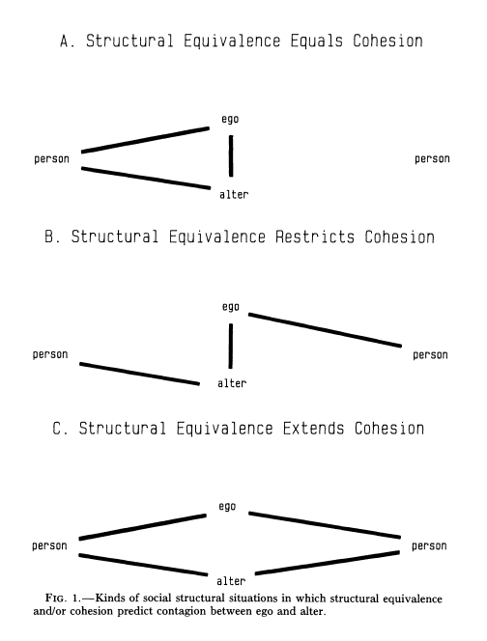
Cohesion (influence) vs. Equivalence (similarity)
Both Equivalence (similar relations with same people) and Cohesion (via strong tie between ego and alter) predict diffusion
Cohesion but not Equivalence predicts restricted contagion (because of conflicting affiliations)
Equivalence predicts contagion via competition for status
Mechanisms
Physical proximity: can "see" alters behaviors
Cohesion: communication, social proximity
Competition, relative standing: structural equivalence
  2 similar physicians keeping up with each other

Slide 7

Diffusion or Contagion?
k = probability of adopting independently
y = proportion who have not adopted
Diffusion: Equal probability (k) of adopting in each time period and for each person
not a function of exposure (p)
Contagion: Equal probability of adopting (k) but also adoption a function of number of others who have adopted.

Slide 8
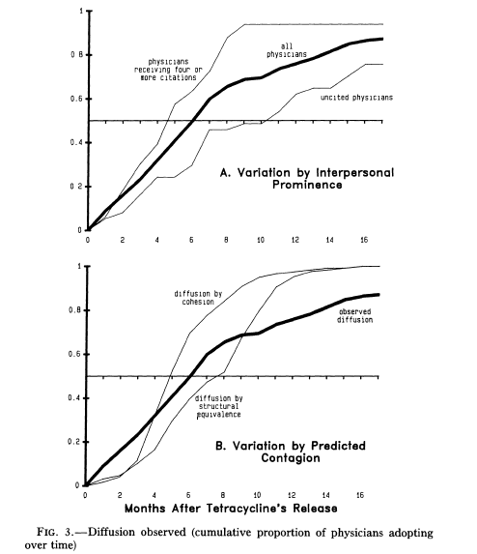
Cumulative Adoption Results
Diffusion by Cohesion: Adoption pattern when ego adopts after alter adopts
Diffusion by Struct. Equiv.:
Adoption pattern when ego adopts after peers adopt
In both cases rate of adoption early on is higher than expected by contagion
Contagion is not the only process at work
High adoption rate early indicative of diffusion without contagion

Slide 9
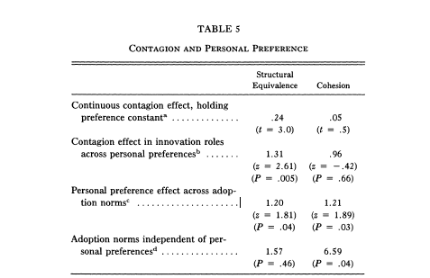
Results
Cohesion: Tie between ego and alter
Structural Equivalence: Euclidian distance between ego and alter (d_{ij}), i.e. how similar their patterns of ties are to others in the network
Results from regressions:
no evidence of contagion from advisors and discussion partners
strong evidence of diffusion between month in which peers adopted (structurally equivalent doctors) and ego adopting
personal factors determined adoption, i.e. predisposition to adopt
contagion independent of personal preference

Slide 10
Implications
Diffusion not via contagion (adjacency) but equivalence
  Why? Relative standing competition. Do not want to be a late adopter.
Heterogeneity in predisposition to adopt leads to critical mass needed to get diffusion by equivalence to take off

Slide 11
Relationship Timing & Diffusion (Moody, 2002)
Static Network: Aggregated pattern of interaction events occurring over time
Diffusion is dynamic & network is dynamic
  ties can appear and disappear
  diffusion chain has a temporal ordering
  B --> C, unless B is already "infected"
  So if A --> B interaction (and transmission) occurs after B --> C, then no diffusion from A --> C
Centrality affects diffusion
  If high degree actor "infected," then probability of many others being infected increases
  "Temporal" degree = concurrency
    e.g., number of concurrent sexual partners
    ties overlap in time

Slide 12
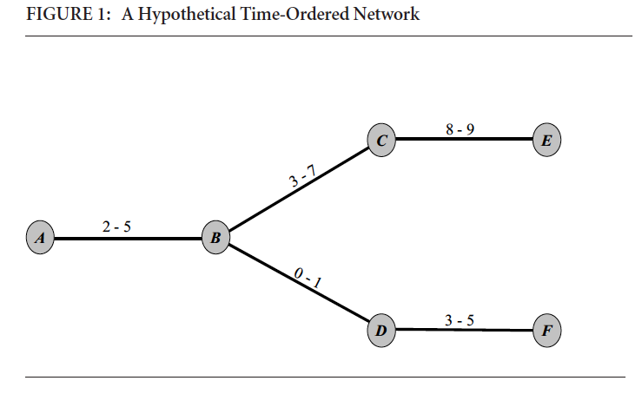
Time-Ordered Networks
start and end times
ignore times and you have a typical fully connected network graph (there is a possible path between any two vertices)
bring in times, and some paths disappear
  D --> A exists, but not A --> D
  A-B concurrent with B-C, so A --> C and C --> A
Diffusion paths: sequences of edges in which each new edge follows the past edges in time

Slide 13
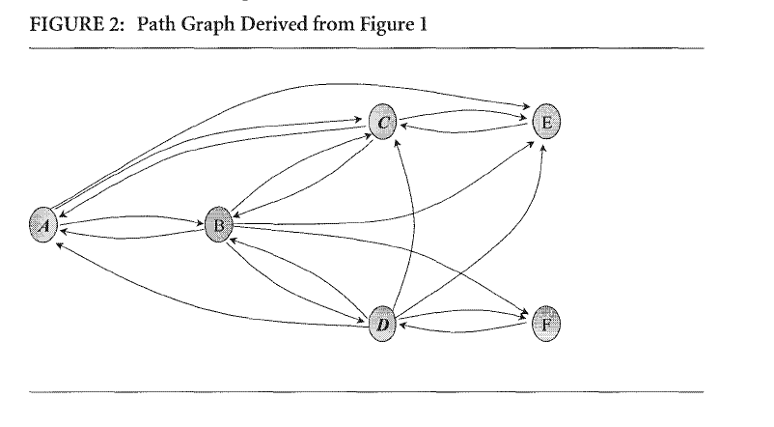
Path Graph
Direct edges get 2 directed arcs
  transmission can go both ways
  e.g. B - D
Indirect paths --> directed arc
  e.g., A - D,
  only arc D --> A
Reachability (density of paths)
  Static Network = 1
  Temporal Network = .6

Slide 14
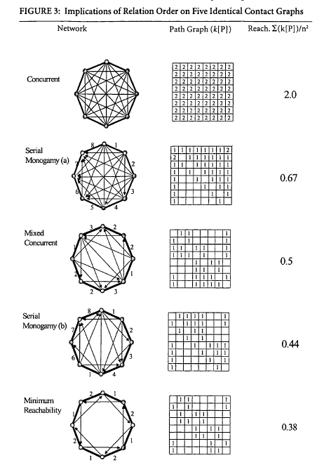
Reachability
8 vertices
heavy lines are ties
timing noted on edges
indirect paths inside circle
Path graph indicates number of temporal paths between two vertices
  Note asymmetry
  Note non-transitivity
Note difference between 2 serial monogamy graph
  1 change in relationship timing leads to big change in reachability
Implications for all measures of centrality that involve paths (e.g. betweeness, closeness)
  and also brokerage

Slide 15
Diffusion Revisited
Possibility of diffusion: time-ordered path
Probability of diffusion:
  pairwise transmission probability (q)
  if q < 1 then diffusion probability = f(number of paths, length of paths)
Diffusion is an emergent property
  depends on one's partner's future partner's

